Slide 1
Human-Computer Interaction
Aleksandra Kurbatova
Jan Rehwaldt

Slide 2
HCI: Human Computer Interaction
The boundaries of information behavior research have extended to understanding the social-psychological effects of including a computer as a member of the team, the role of emotional state on search engine efficacy and the reduction in information overload experienced in 2D and 3D data spaces.
Human information behavior research is found in the LIS literature decades before the introduction of information technology.
increase in the likelihood of information use when texts and video are made available online and do not require a visit to a library building

Slide 3
HIB: Human Information Behaviour
information production may be automated (structured task)
information access is analyzed by HCI
information utilization (semi-structured tasks) is covered by HIB

Slide 4
HIB: Human Information Behaviour
How do people search for and utilize information provided in information systems?
How does behaviour change depending on different information sources and channels?
facebook, ÕIS, Google, …

Slide 5
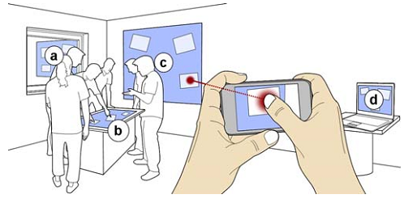
HCI research leads to HIB research

Slide 6
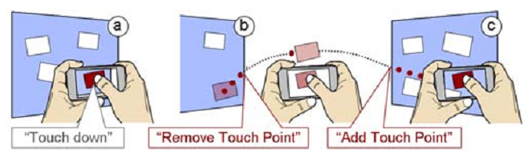
HCI innovates computer usage techniques
analyze techniques helping to focus on information
zoom capability for mobile device
temporarily freezing of captured image
virtual preview – update frozen image
increasing the user performance with respect to finding information

Slide 7
Goals of …
HCI research
HIB research
increase task execution speed
lower failure rates
remove usage barriers
establish new ways how to access information
analyze how users combine multiple systems
find means to improve system interaction and search experience
identify impact of HCI innovations

Slide 8
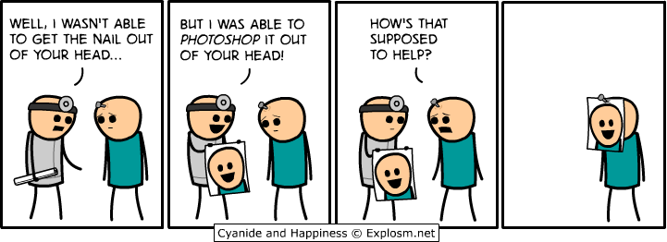
How‘s that supposed to help?

Slide 9
TASK
In groups assigned at lecture and Wiki - prepare presentation of 3 HCI articles in 5 minutes. Upload the visual aid for such presentation (PDF)
Good presentations are catchy, visually pleasing, manage to uphold other listeners attention and are not just sequential presentation of individual work, but attempt some sort of meta-level analysis or overview. Good presentations also look beyond the previous overviews for additional inspiration and/or present concrete guidelines or lessons learned from reading materials.

Slide 10
Ok, what‘s the problem?

Slide 11
